Slide 1

lymphatic system and over view of circulation
Dr P. Mary Anupama
Assistant Professor
Dept. of Biochemistry
St. Joseph’s college for Women (A)
Visakhapatnam

Slide 2
contents
Composition and functions of lymph and lymphatic system
Overall design of circulatory system- pulmonary and systemic circulation

Slide 3
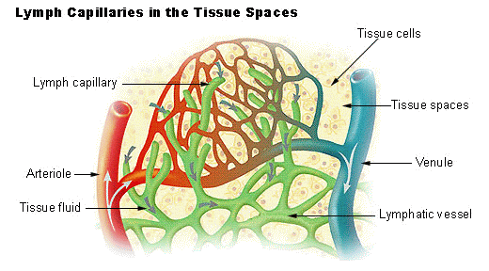
LYMPH AND LYMPHATIC SYSTEM
Lymph is the fluid that flows through the lymphatic system, a system composed of lymph vessels (channels) and intervening lymph nodes whose function, like the venous system, is to return fluid from the tissues to the central circulation.

Slide 4
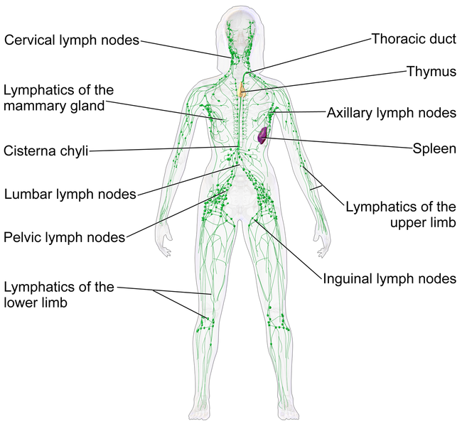
LYMPHATIC SYSTEM

Slide 5
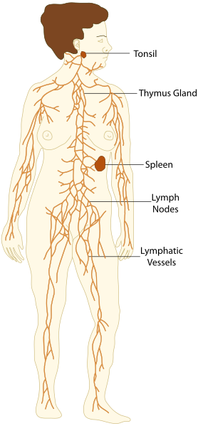
The lymphatic system consists of a conducting network of lymphatic vessels, lymphoid organs, lymphoid tissues, and the circulating lymph.
The primary (or central) lymphoid organs generate lymphocytes from immature progenitor cells. The thymus and the bone marrow constitute the primary lymphoid organs involved in the production and early clonal selection of lymphocyte tissues
Bone marrow is responsible for both the creation of T cells and the production and maturation of B cells.

Slide 6
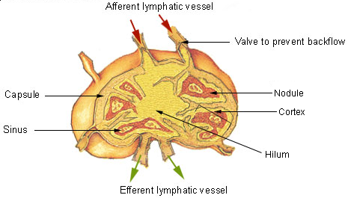
The thymus increases in size from birth in response to postnatal antigen stimulation. It is most active during the neonatal and pre-adolescent periods.
The secondary (or peripheral) lymphoid organs (SLO), which include lymph nodes and the spleen, maintain mature naive lymphocytes and initiate an adaptive immune response.

Slide 7
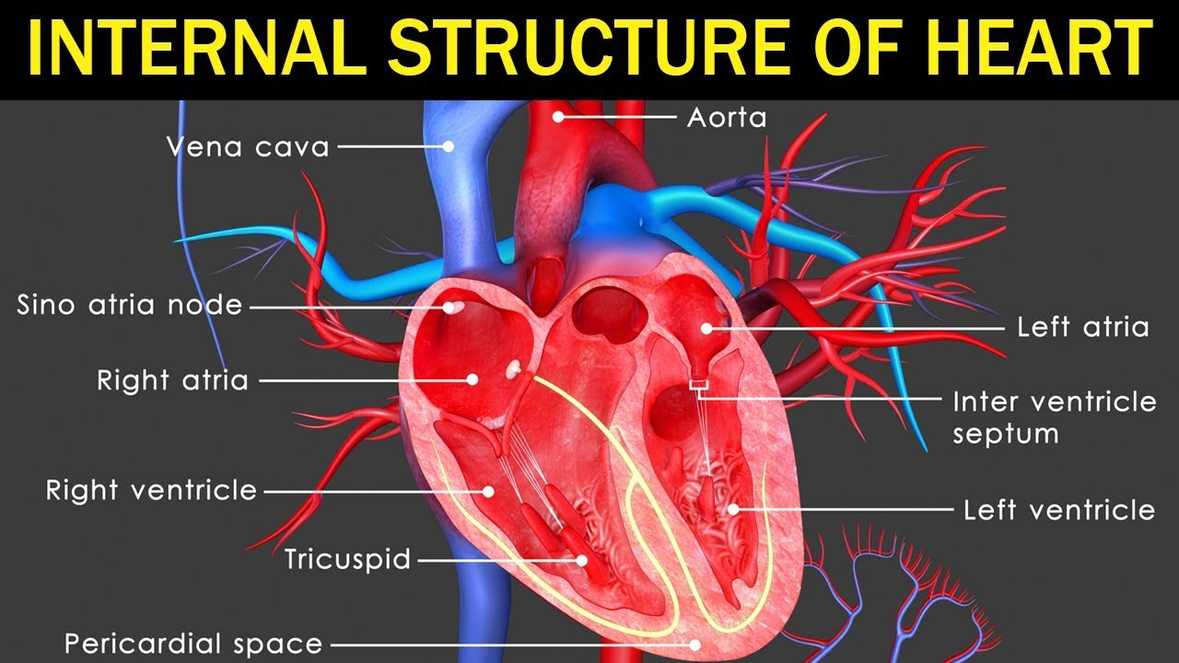
OVER ALL VIEW OF CIRCULATION

Slide 8
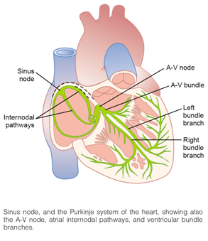
The contraction and relaxation of the heart – the heartbeat – is controlled by the sinus node, which is a cluster of cells situated at the top of the right atrium.
The sinus node sends electrical signals through the electrical conduction system of the heart that direct the muscle to contract or relax.

Slide 9
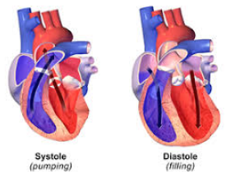
The heartbeat is divided into two phases: the systole and diastole phases.
In the first, the ventricles contract and push blood out into the pulmonary artery or the aorta.
At the same time, the valves separating the atria and ventricles snap shut to prevent blood from flowing backwards.
In the diastole phase, the valves connecting to the atrium open, and the ventricles relax and fill with blood. The sinus node controls the pace of these two phases.

Slide 10
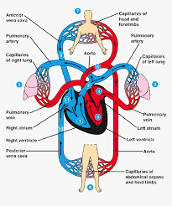
OVER VIEW OF CIRULATION

Slide 11
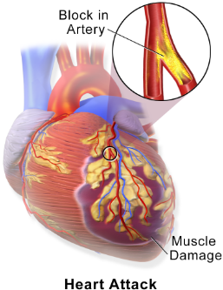
Heart diseases
Heart disease is a broad term that covers a wide range of diseases and disorders, including stroke (the blockage of blood to the brain), heart attack (the flow of blood to the heart is blocked), hypertension (high blood pressure causing the heart to work harder), arteriosclerosis (the arteries become thick and stiff) and aneurysm (a damaged blood vessel that can lead to internal bleeding

Slide 12
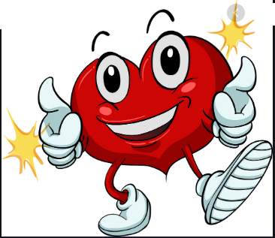
Thank you

